Slide 1


Nick
18th July 2025

Slide 2

Outline
Executive Summary
Introduction
Methodology
Results
Conclusion
Appendix

Slide 3
Executive Summary
Analyzed launch data with visualizations and SQL
Developed and optimized predictive models
Success rates improved over time
Performance varies by launch site, payload, and orbit
Decision Tree Model achieved 80% precision and 100% recall
Insights enable SpaceY to better predict Falcon 9 landing outcomes to know where to compete with SpaceX

Slide 4
Introduction
Background
SpaceX has revolutionized space travel by successfully reusing booster rockets, significantly reducing the cost of space missions. Their Falcon 9 rocket’s ability to land and be reused gives them a competitive edge in the commercial launch industry
Problem Statement
As a data scientist at SpaceY, our goal is to predict whether the Falcon 9’s first stage will successfully land. Accurate predictions will help estimate launch costs and develop a cost-effective strategy to compete with SpaceX in the commercial launch market.

Slide 5

Section 1

Slide 6
Methodology
Executive Summary
🔍 Data Collection
SpaceX API:
Rockets, Launch Pads, Payloads, Cores, Past Launches
Web Scraping:
Wikipedia page of Falcon 9 launches
🧹 Data Wrangling & Preparation
Converted landing outcome to binary classes (Success / Failure)
One-hot encoded categorical variables
Imputed missing values
Normalized data types
📊 Exploratory Data Analysis (EDA)
Used SQL queries and visualization libraries
Created interactive visual dashboards using Plotly Dash
Geospatial mapping with Folium
🤖 Predictive Modeling
Applied classification models:
Logistic Regression, SVM, Decision Tree, KNN
Used GridSearchCV for hyperparameter tuning
Evaluated models with Confusion Matrix to assess Type I and II errors

Slide 7
Data Collection
SpaceX API
Pulled structured data on:
Past launches
Launchpads
Rocket Cores
Payload details
Accessed via public REST API using Python requests module
Web Scraping Wikipedia
Scraped Falcon 9 launch data table
Extracted additional features like mission names and launch outcomes
Used BeautifulSoup for HTML parsing

Slide 8
Data Collection – SpaceX API
🔹 SpaceX API – Data Extraction
Used Python’s requests package to issue GET requests
Queried the following endpoints:
/launches/past – Base dataset (static URL for consistency)
/rockets, /payloads, /launchpads, /cores – Supplemental details
Parsed JSON responses and converted to Pandas DataFrame
Merged datasets using common IDs (e.g., rocket_id, payload_id)
🔗 Github link
SpaceX Past Launches API
Extract JSON to Pandas DataFrame
Query SpaceX Rockets API
Query SpaceX Payloads API
Query SpaceX Launch Pads API
Query SpaceX Cores API

Slide 9
Data Collection - Scraping
🔹 Wikipedia Web Scraping
Issued a GET request to the Wikipedia page on Falcon 9 launches
Parsed the HTML content using BeautifulSoup
Located and extracted the first launch table using the <table> tag
Extracted column headers by looping through all <th> tags
Extracted row data by iterating through <tr> tags and capturing each cell’s content
🔗 GitHub link
GET Request to Wikipedia
Parse HTML with BeautifulSoup
Locate First <table> tag
Extract Column Headers from <th> tags
Extract Row Data from <tr> tags
Convert to Pandas DataFrame

Slide 10
Data Wrangling
🔹 Merging & Structuring Data
Merged launch data with payload, rocket, core, and launchpad data using unique IDs
Flattened nested JSON structures from the API
🔹 Cleaning & Normalization
Converted landing outcome to binary labels (1 = Success, 0 = Failure)
Standardized column datatypes
🔹 Handling Missing Values
Imputed missing payload masses with the mean
🔹 Feature Engineering
One Hot Encoded categorical variables
🔗 GitHub link

Slide 11
EDA with Data Visualization
🔍 Exploratory Data Analysis (EDA)
Investigated how key variables relate to launch success
Analyzed trends in:
Payload mass
Flight number
Orbit type
Launch site
Year of launch
Identified patterns and correlations with landing outcomes
Found improvement in success rate over time
Guided feature selection for predictive modeling
🔗 GitHub link

Slide 12
EDA with SQL
🗄️ SQL-Based Data Exploration
Queried unique launch sites and filtered for those starting with 'CCA'
Summed payloads for NASA CRS missions
Calculated average payload for Falcon 9 v1.1
Identified first successful landing on a ground pad
Filtered for drone ship successes with payloads between 4000–6000 kg
Counted total mission outcomes: Success vs. Failure
Found boosters that carried the maximum payload
Retrieved drone ship failures in 2015
Ranked landing outcomes between 2010-06-14 and 2017-03-20
🔗 GitHub link

Slide 13
🗺️Interactive Map with Folium
🟢 Circles for Launch Sites Represented all known SpaceX launch sites to provide geographic context
🔴🟢 Color-Coded Markers for Each Mission Plotted individual launches, colored by success (green) or failure (red), to visualize performance across locations
📏 Polylines to Shorelines & Railroads Drew lines from launch sites to nearest shorelines and railroads to analyze proximity to infrastructure and its potential impact on launch logistics
🔗GitHub link

Slide 14
Dashboard with Plotly & Dash
Visualized distribution of successful launches to identify top-performing sites
Highlighted each sites success rate when filtered
Analyzed payload size and booster version influence on mission success
Enabled customization of scatter plot using Payload Mass slider
🔗GitHub link

Slide 15
Predictive Analysis (Classification)
Converted target to NumPy array and standardized features using StandardScaler
Split data 80/20 into training and test sets
Tuned Logistic Regression, SVM, Decision Tree, and KNN using Grid Search
Used random_seed = 0 for reproducibility
Evaluated each model’s accuracy and confusion matrix
Selected best model through systematic tuning and evaluation
🔗GitHub link

Slide 16
Results
Conducted exploratory data analysis to understand data characteristics
Developed interactive analytics dashboard
Built and evaluated predictive models to assess performance

Slide 17

Section 2

Slide 18
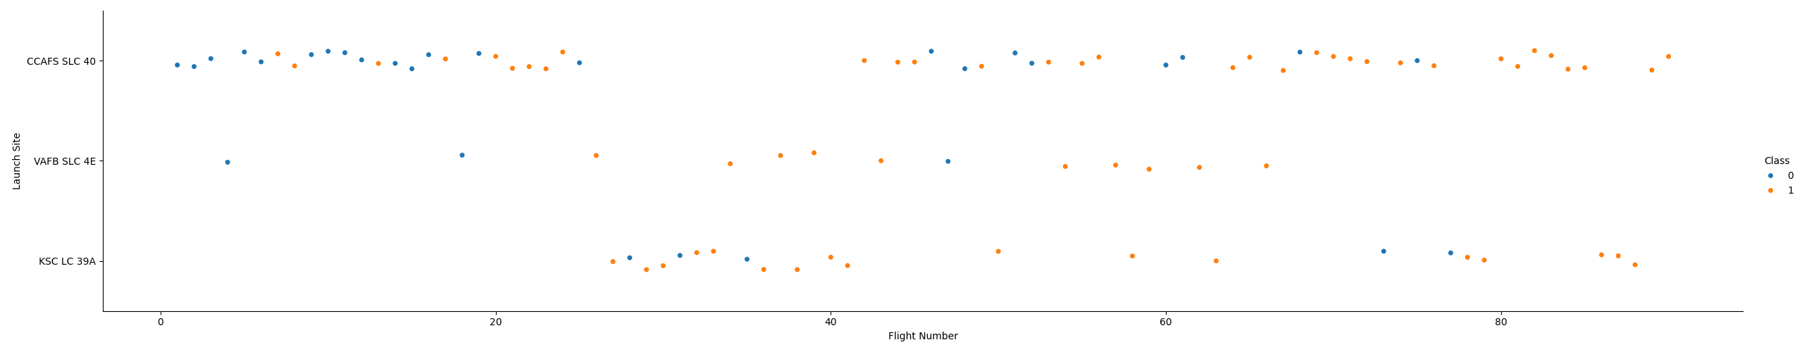
Flight Number vs. Launch Site
Early SpaceX launches had high failure rates
Success rate improved steadily with more launches
Some variation in success by launch site

Slide 19
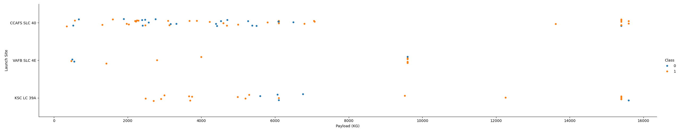
Payload vs. Launch Site
Launch site performance varies by payload mass
CCAFS SLC 40 has more successes with heavier payloads
KSC LC 39A had most of its failures with payloads around 6000 KG

Slide 20
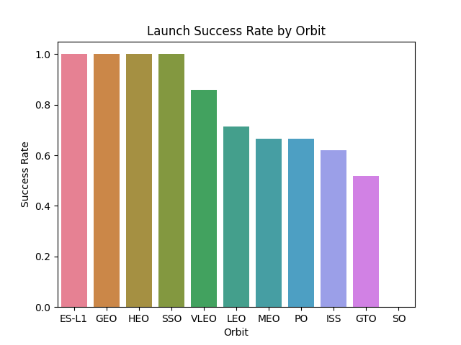
Success Rate vs. Orbit Type
ES-L1, GEO, HEO, & SSO are the most successful orbits for launches
SO has not had a successful launch

Slide 21
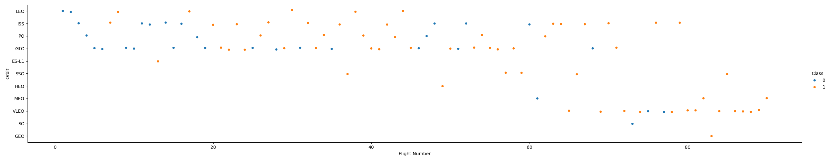
Flight Number vs. Orbit Type
GEO, ES-L1, HEO & SO have only one recorded flight each
The first flight was LEO which could attribute to its lower success rate
Most successful orbits have limited flight data, reducing reliability of conclusions

Slide 22
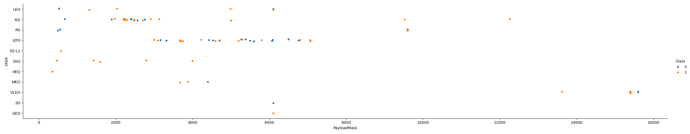
Payload vs. Orbit Type
Orbit success varies by payload weight
GTO shows many successes around 4000 KG & 7000 KG
VLEO & PO have higher success rates with payloads above 10,000 KG

Slide 23
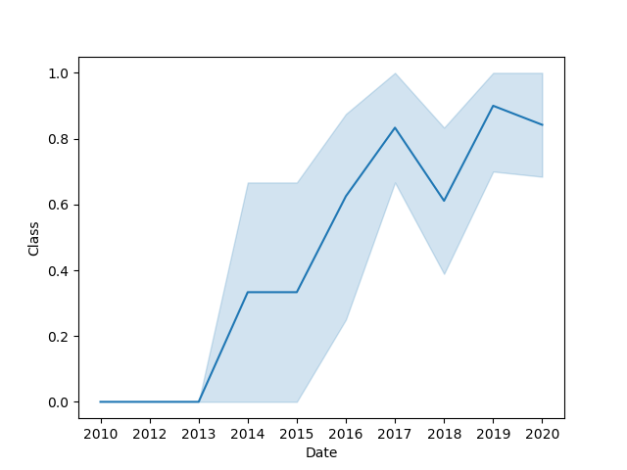
Launch Success Yearly Trend
Successful launches have increased over time

Slide 24
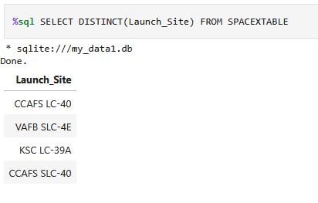
All Launch Site Names
Applied DISTINCT to show unique Launch Sites

Slide 25
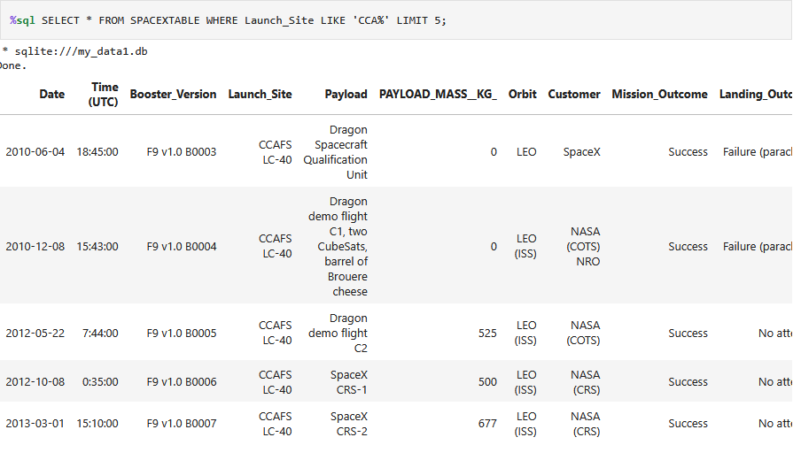
Launch Site Names Begin with 'CCA'
Used the LIKE operator to find all Launch Sites that contain CCA

Slide 26
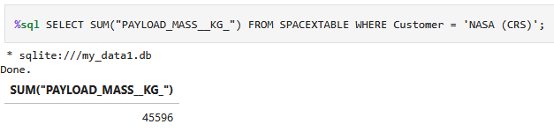
Total Payload Mass
Aggregated Payload weights to find the total Payload Mass for NASA

Slide 27
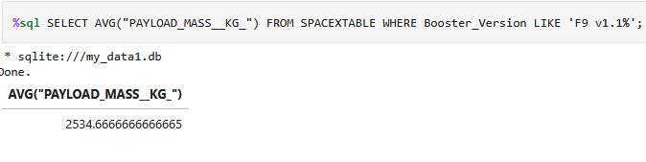
Average Payload Mass by F9 v1.1
Calculated average payload using AVG()
Filtered results to the Booster Version matching F9 v1.1

Slide 28
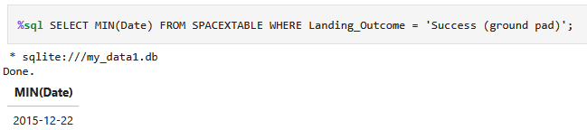
First Successful Ground Landing Date
Filtered results to successful ground pad launches
Used MIN to identify the first successful launch date

Slide 29
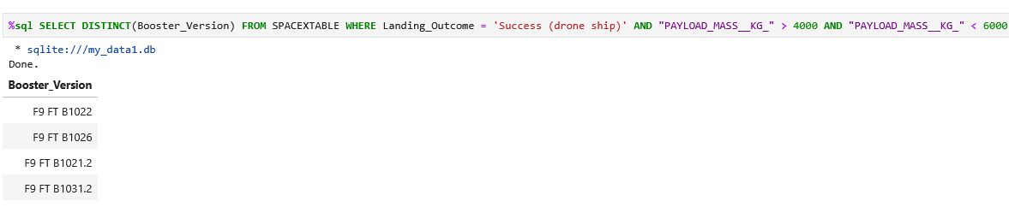
Successful Drone Ship Landing with Payload between 4000 and 6000
Retrieved unique booster version names with DISTINCT
Filtered results to Successful Drone Ship landing outcomes
Filtered the payload to between 4000 and 6000 KG

Slide 30
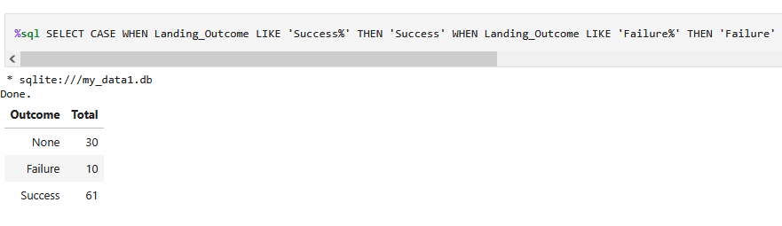
Total Number of Successful and Failure Mission Outcomes
Used a CASE statement to categorize landings as successful or failed
Calculated totals using COUNT()
Used GROUP BY to group the counts by the successes and failures

Slide 31
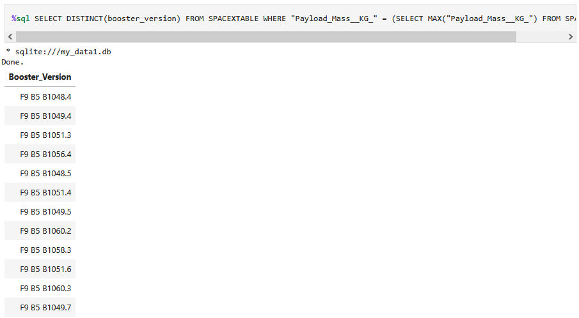
Boosters Carried Maximum Payload
Used a subquery to find the max payload
Filtered the table to where the payloads equaled the max
Used DISTINCT to find all the Boosters that had the max payload

Slide 32
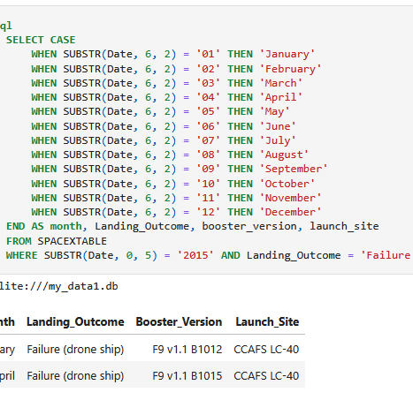
2015 Launch Records
Used the SUBSTR function with a CASE statement to convert month numbers to names
Filtered data to year 2015 and launch failures

Slide 33
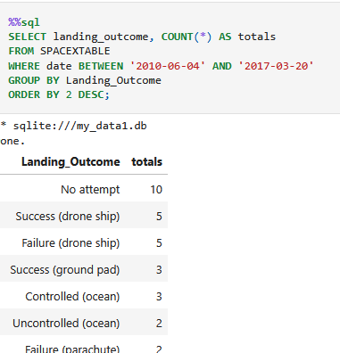
Rank Landing Outcomes Between 2010-06-04 and 2017-03-20
Used COUNT() to get the counts for each landing outcome
Filtered data between 2010-06-04 and 2017-03-20
Grouped results by landing outcome
Ordered by counts descending to rank outcomes

Slide 34

Section 3

Slide 35
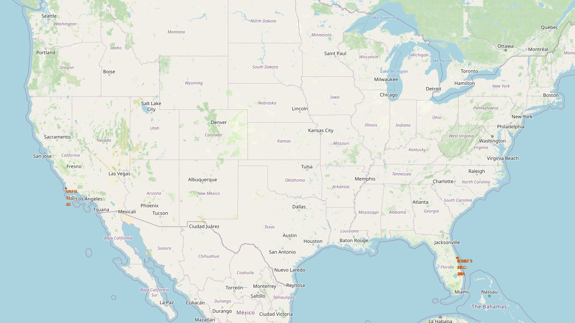
Launch Site Locations
Mapped all SpaceX Launch Site Locations
All sites are in the United States
Launch sites located in Florida and California

Slide 36
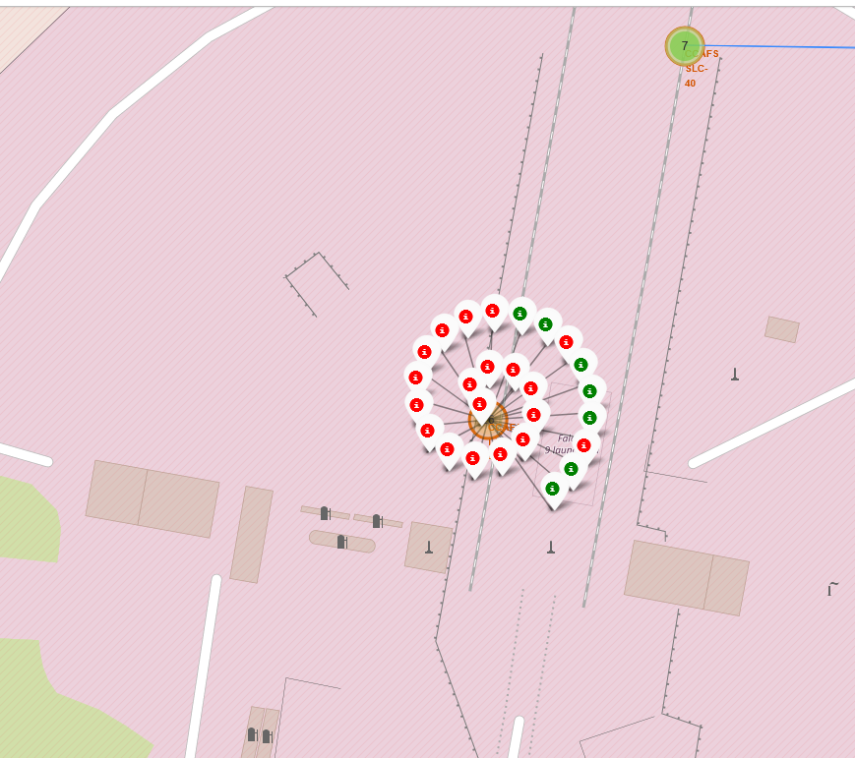
Launch Site Landing Outcomes
Displayed individual launch site with all associated launches
Launch outcomes are color coded
Green = Success
Red = Failure

Slide 37
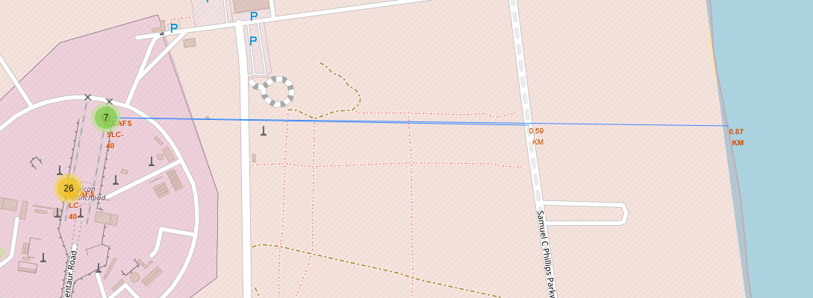
Launch Site Distance to Populace
Visualized distance from launch site to nearby infrastructure
Example Launch Site is 60KM from the closest railroad
Example Launch Site is 90 KM from the shoreline

Slide 38

Section 4

Slide 39
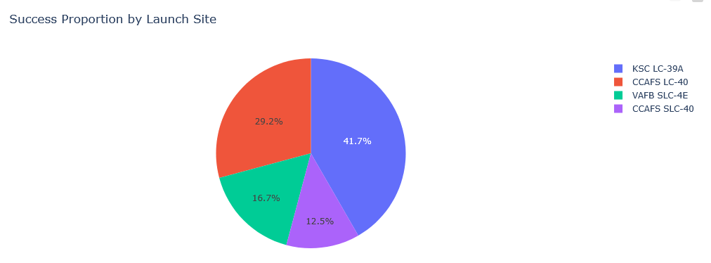
KSC LC-39A has the most successful launches
CCAFS SLC-40 has the least successful launches
Launch Sites Success Rates

Slide 40
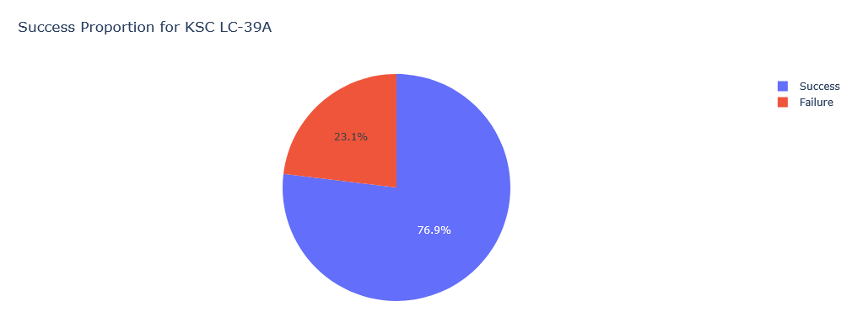
Success and Failure proportion of specific launch sites
KSC LC-39A is successful in ~77% of its launches
Launch Site Success Rate

Slide 41
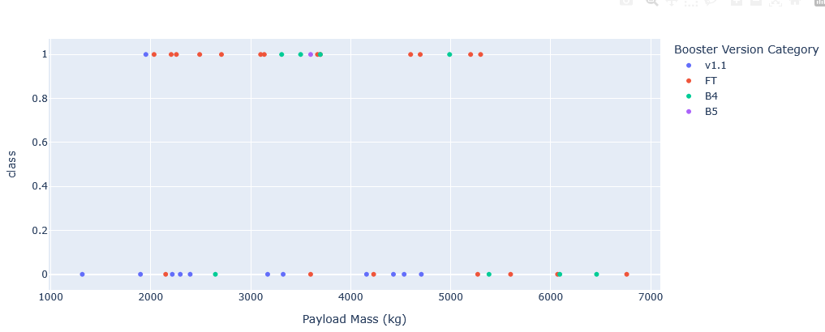
Payloads < 4000 KG has more successes
Booster FT has the most successes
Booster Successes by Payload

Slide 42

Section 5

Slide 43
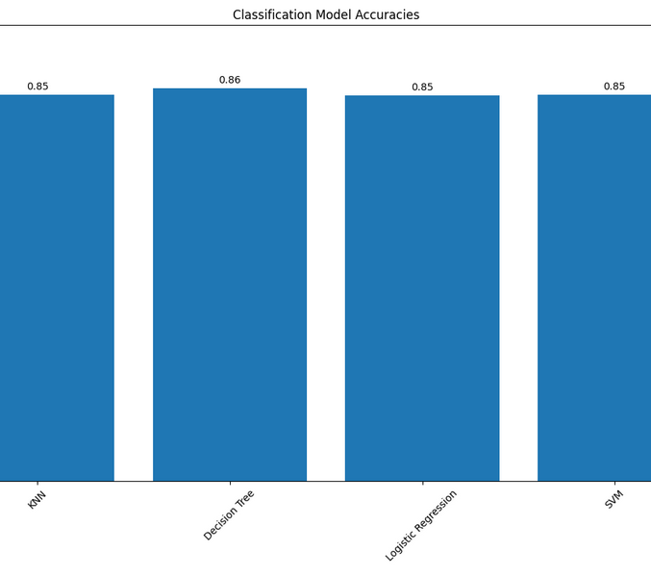
Classification Accuracy
Decision Tree has the highest Classification Accuracy on the training set
Similar accuracies were found on the test set indicating good generalization
Best hyperparameters
Criterion: gini
Max Depth: 6
Max Features: sqrt
Min Samples Left: 4
Min samples split: 10
Splitter: random

Slide 44
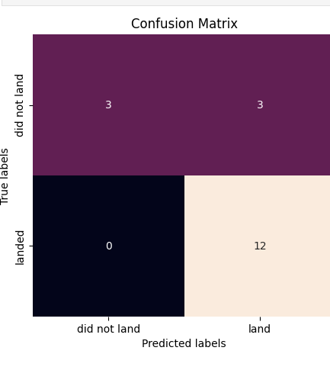
Confusion Matrix
Precision: 80% (correct positive predictions)
Recall: 100% (all actual positives identified)

Slide 45
Conclusions
SpaceX launch success rates have improved each year
Launch site performance varies notably by payload and orbit
Decision Trees provided the most accurate classification of launch outcomes
Supported by strong precision and high recall
Precision showing some false positives which could affect the pricing

Slide 46


